Slide 1
WEEK 2: LESSON -3
Mass spectrometry

Slide 2
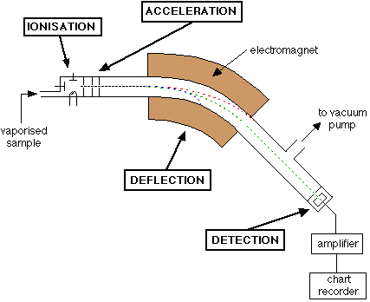

Slide 3
Mass spectrometry is based on the different masses of atoms in a sample.
It can be used to determine what elements are present in a sample material, or what isotopes are present in an element.
This method is focused on how it is used to determine the isotopic composition of an element. An isotopic composition tells you which isotopes are present in an element and the percentage of each isotope present.

Slide 4
Mass spectrometry is based on the different masses of atoms in a sample.
It can be used to determine what elements are present in a sample material, or what isotopes are present in an element.
This method is focused on how it is used to determine the isotopic composition of an element. An isotopic composition tells you which isotopes are present in an element and the percentage of each isotope present.

Slide 5
During mass spectrometry, the sample is bombarded with high-energy electrons or ultraviolet. This knocks out or removes electrons, leaving the atom with an overall positive charge.
The positive ions in the sample are accelerated through an electric field so they all move at high speeds. They then pass through a magnetic field where they undergo deflection according to their masses. Lighter ones are deflected more by the magnetic field, heavier ions are deflected less.

Slide 6
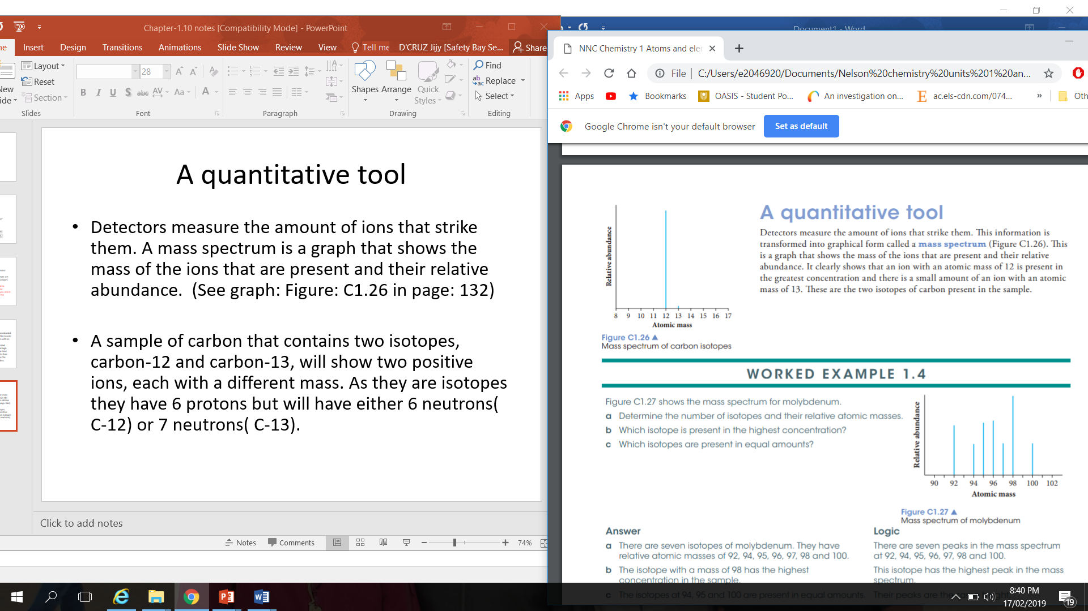
A quantitative tool
Detectors measure the amount of ions that strike them. This information is transformed into graphical form called a mass spectrum. A mass spectrum is a graph that shows the mass of the ions that are present and their relative abundance. (See graph: Figure: C1.26)
A sample of carbon that contains two isotopes, carbon-12 and carbon-13, will show two positive ions, each with a different mass. As they are isotopes they have 6 protons but will have either 6 neutrons( C-12) or 7 neutrons( C-13).

